Slide 1
North South University
Department of Electrical & Computer Engineering Junior Project weekly presentation -8
Title of the Project : Create your own identity Name and IDs of the students:
1.Smita Roy Jyoti 1711615042 2.Shawon Das 1712591642
Faculty’s Name: Intisar Tahmid Naheen (Itn) Submission Date : 22-09-2020

Slide 2
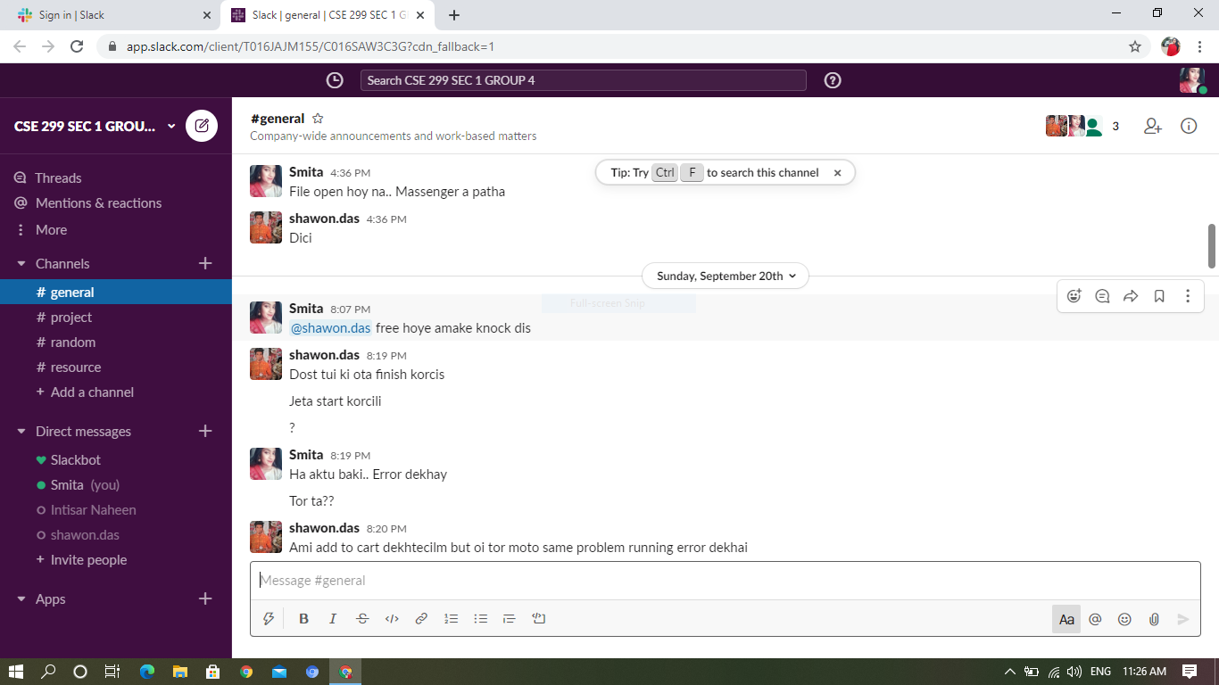
SLACK
Our conversation after the 7th week presentation on Slack is given below by screen shots…….

Slide 3
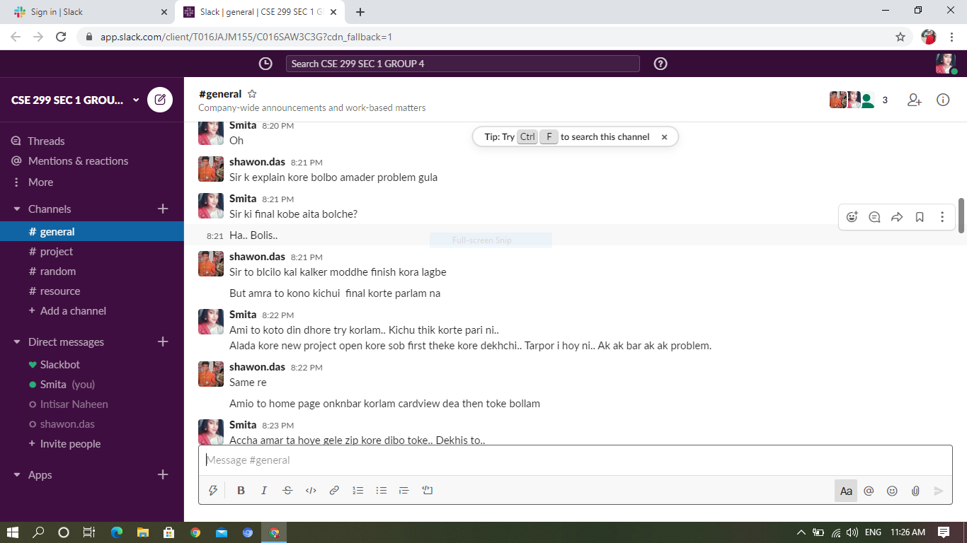
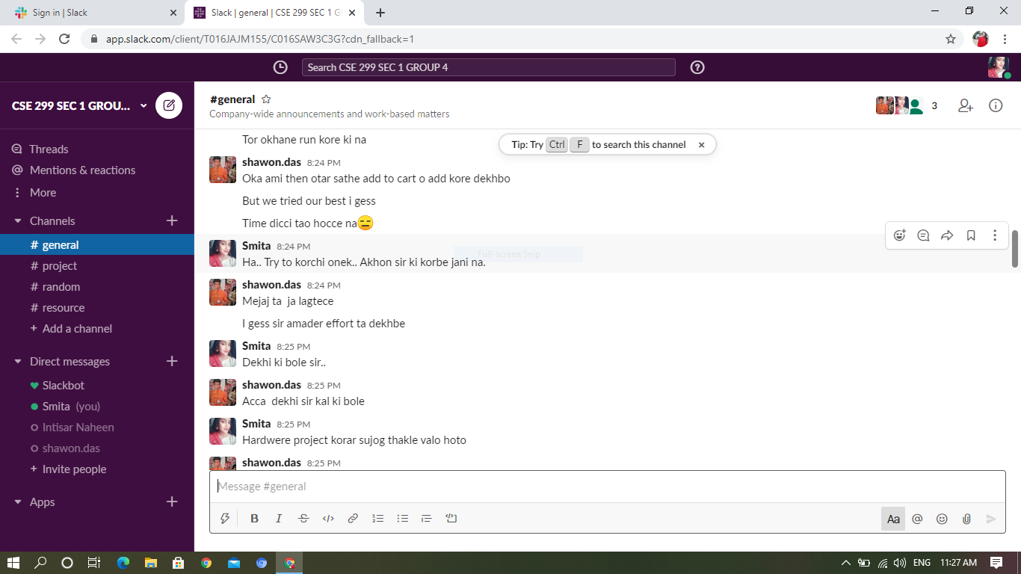

Slide 4
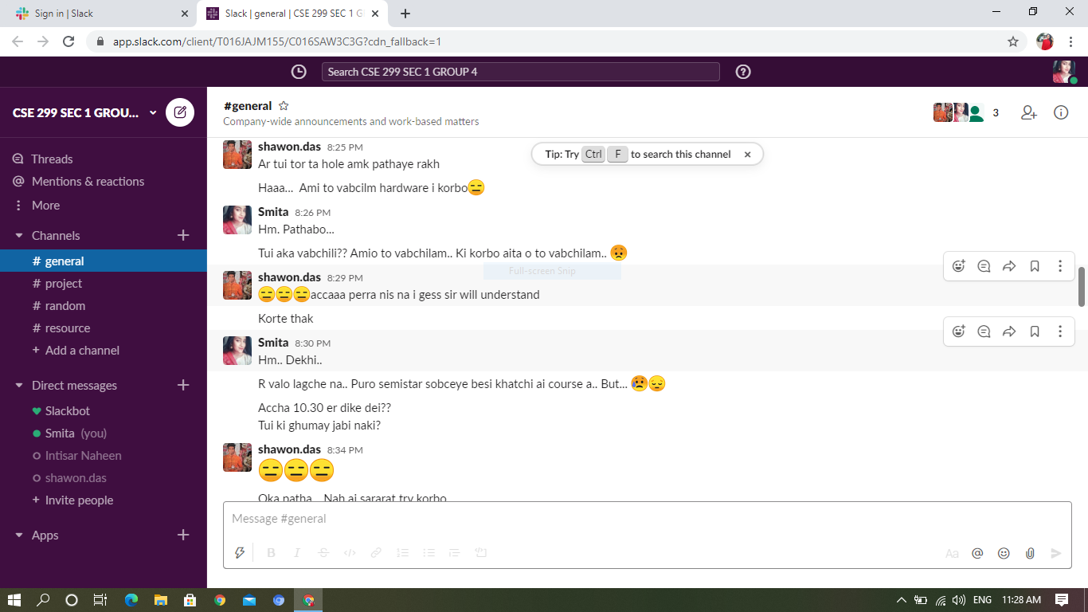
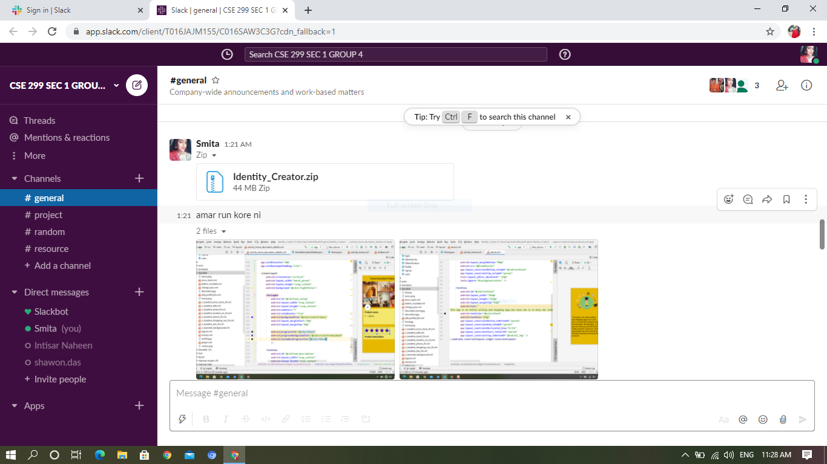

Slide 5
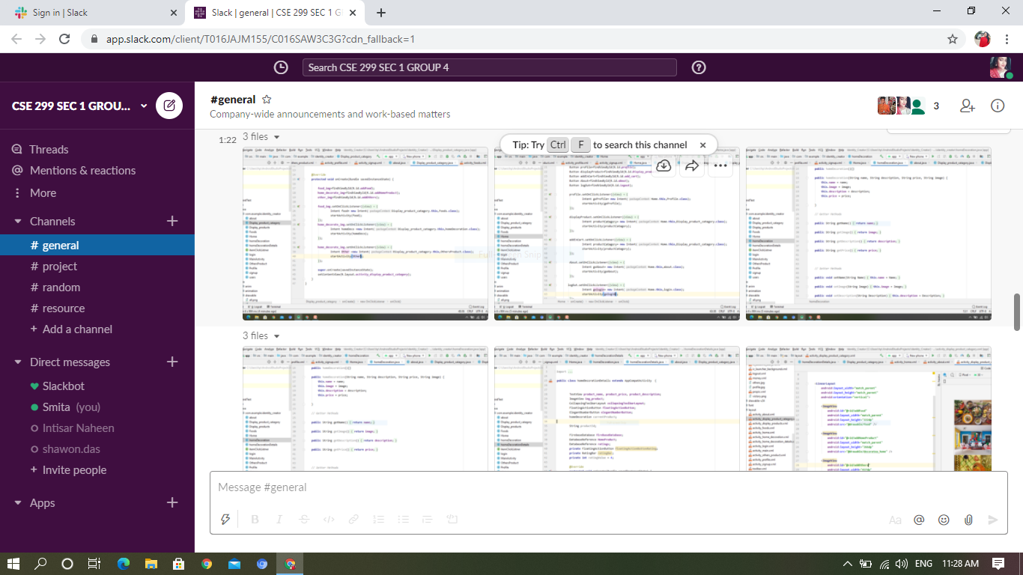
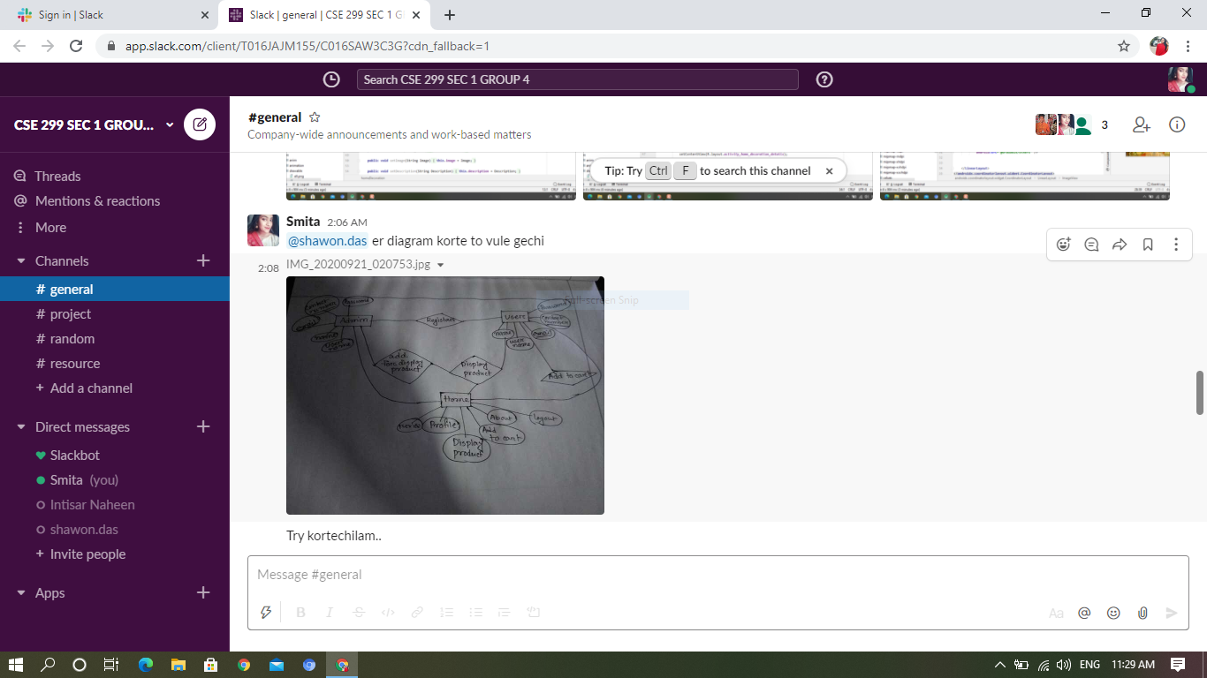

Slide 6
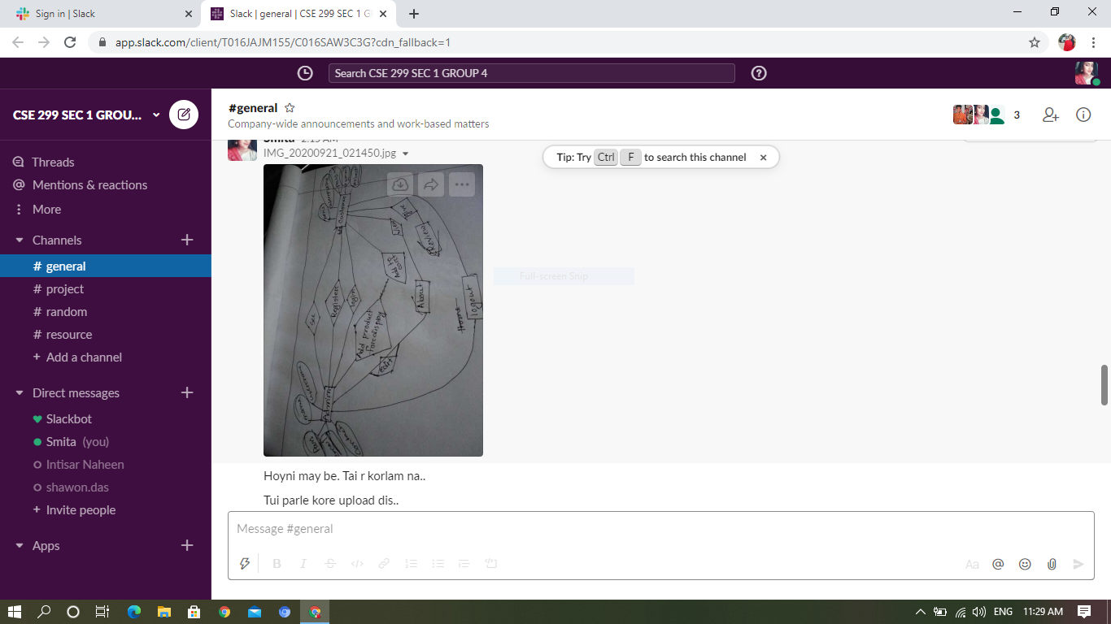
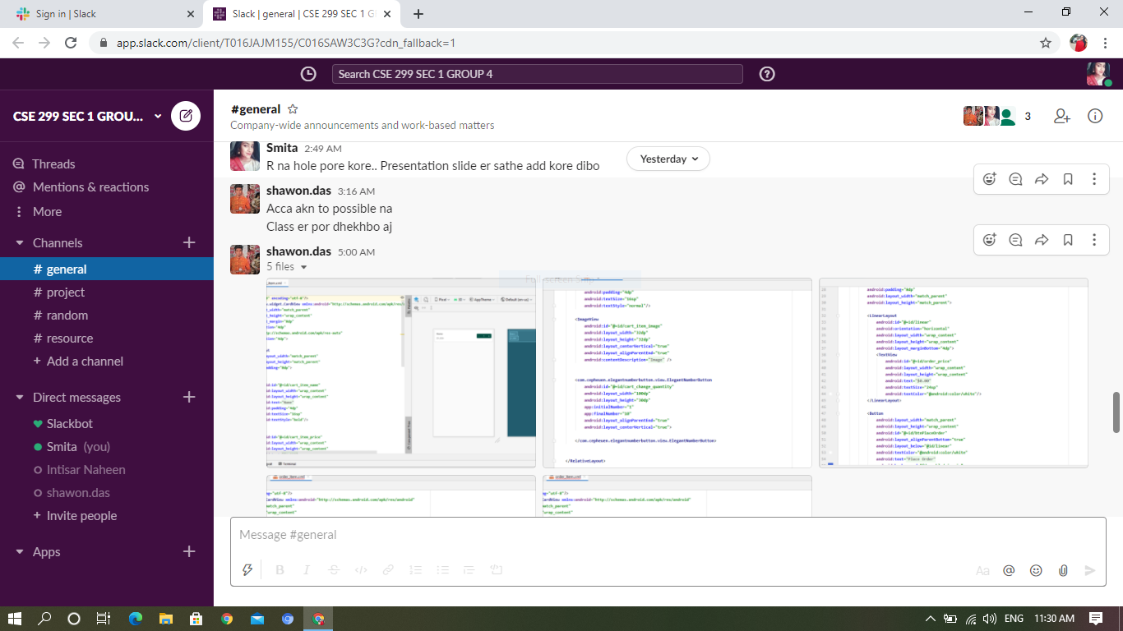

Slide 7
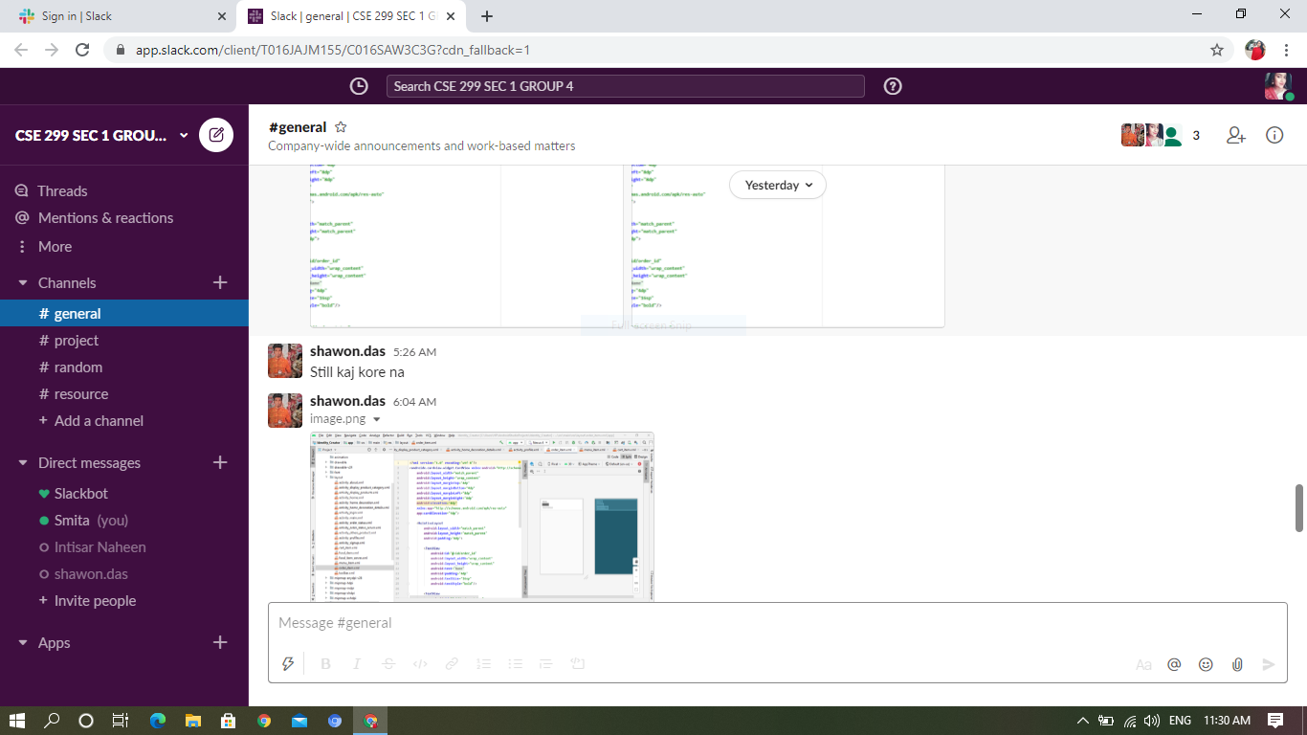

Slide 8
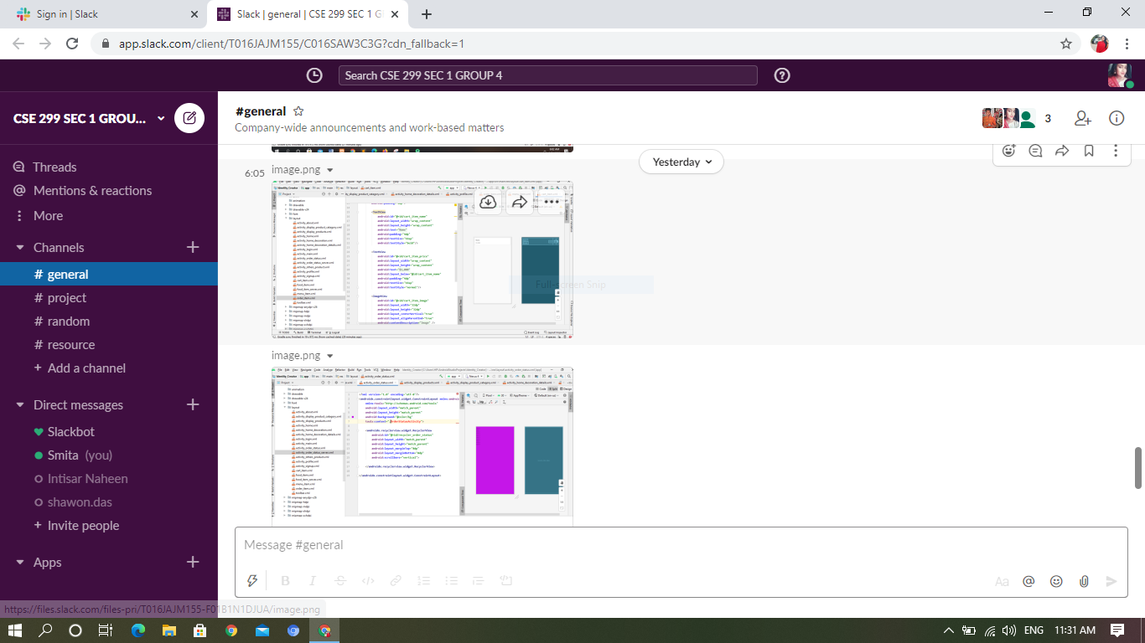

Slide 9
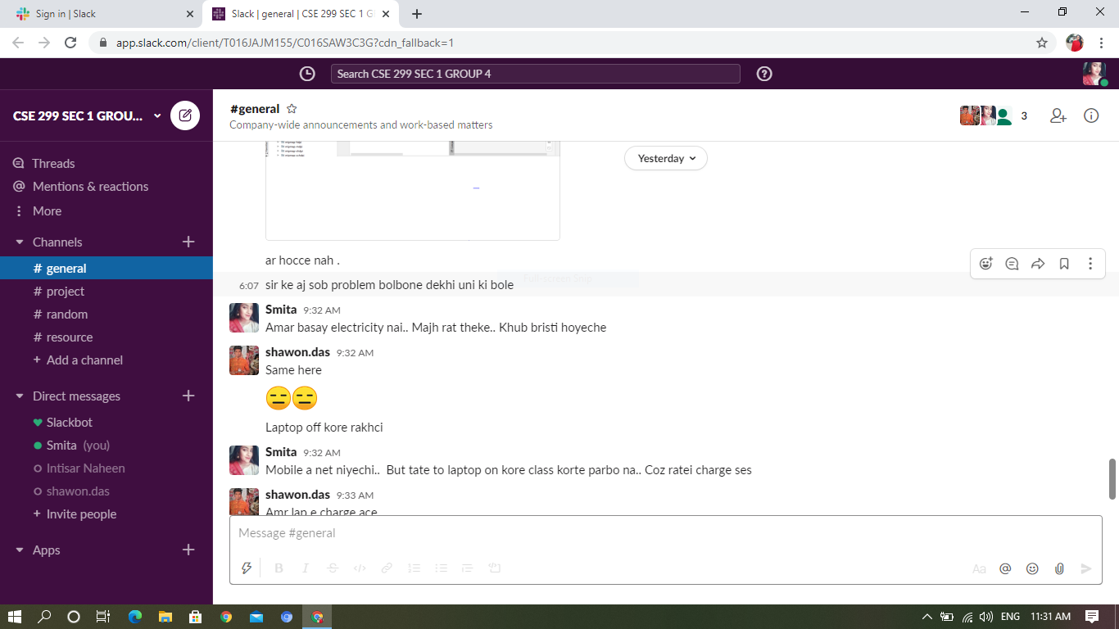

Slide 10
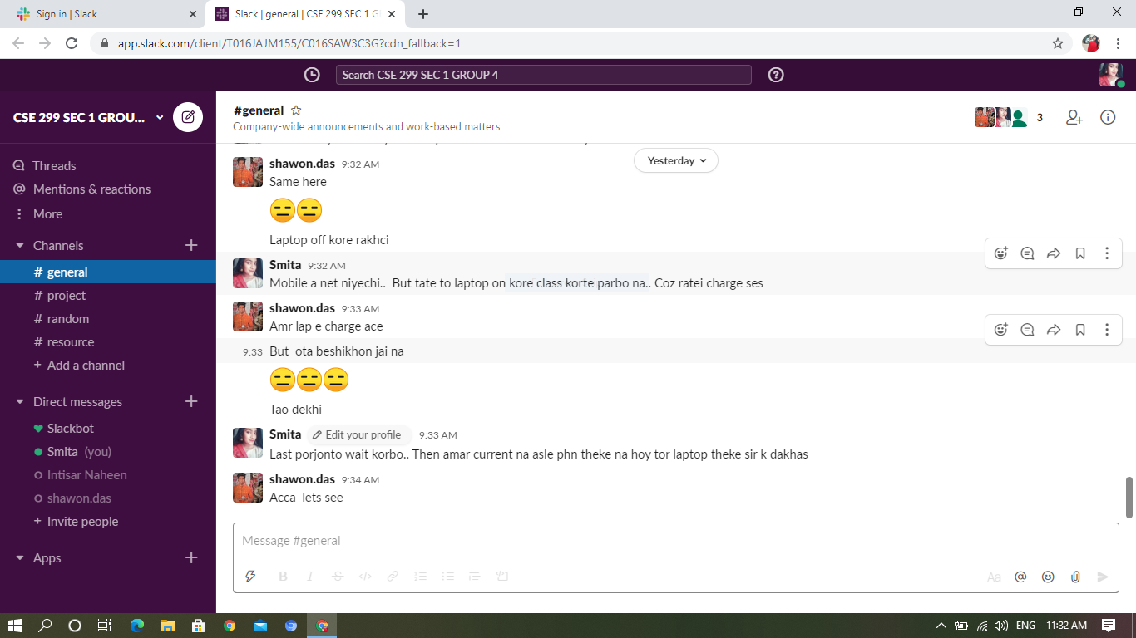

Slide 11
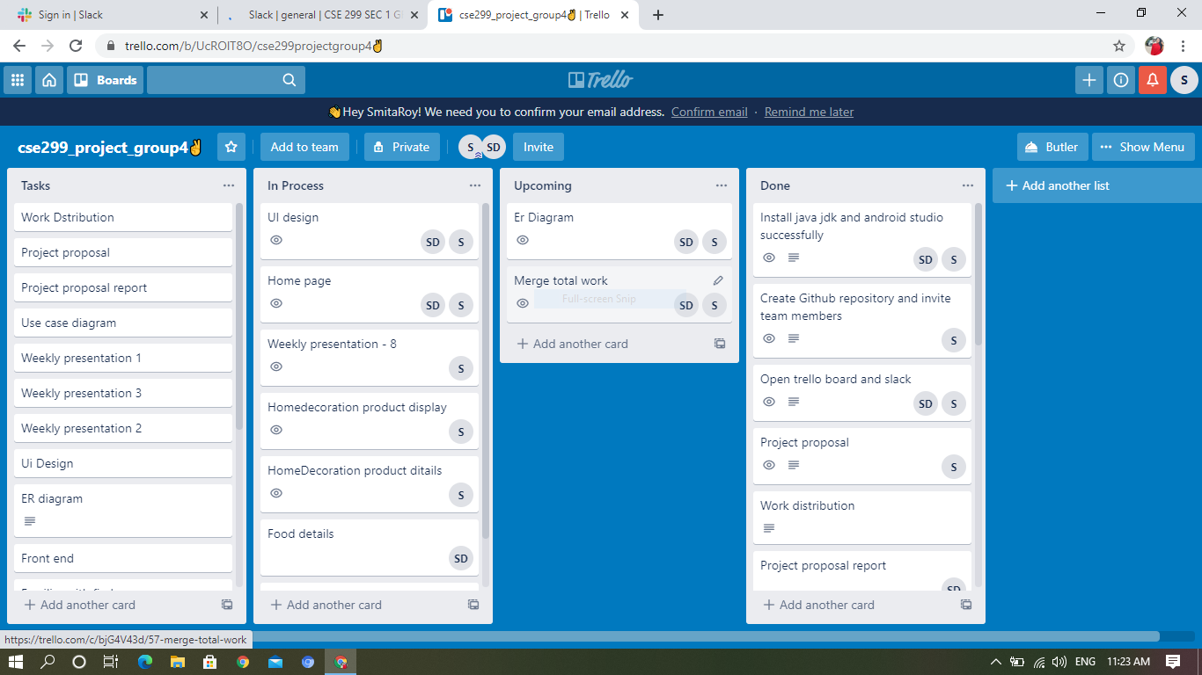
Trello

Slide 12
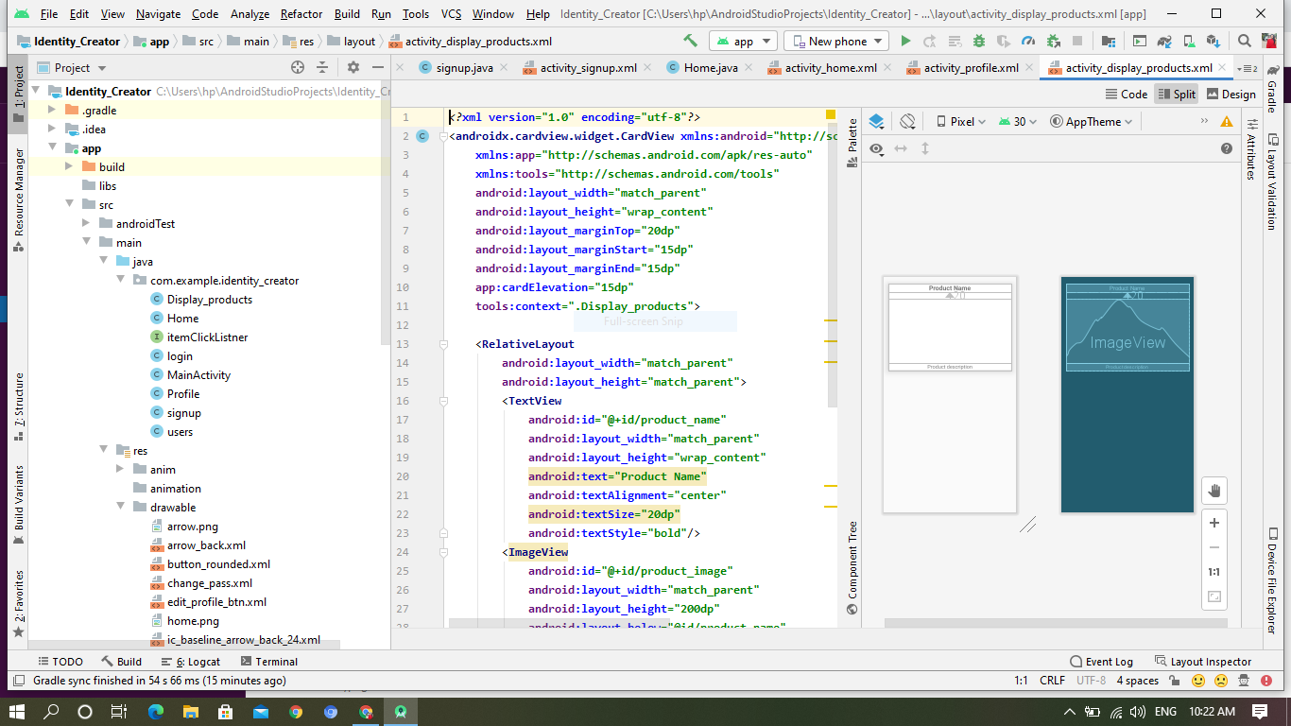
CODE
Our coding part of week 8. We tried our best but our project is not running properly.
Coding Part of Smita Roy Jyoti :

Slide 13
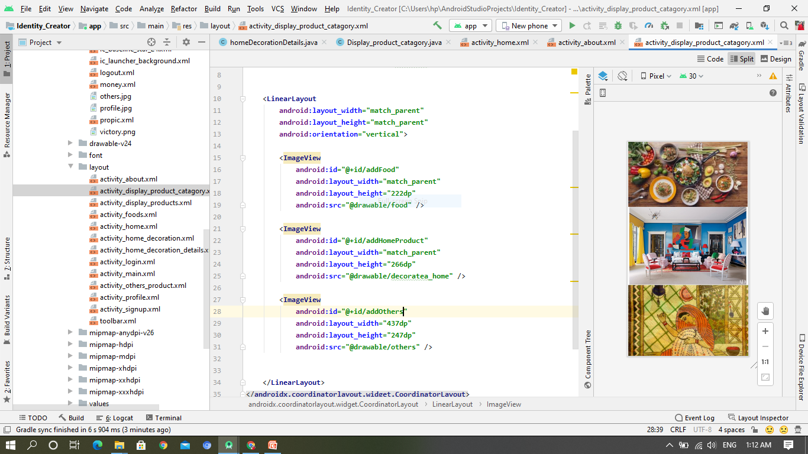

Slide 14
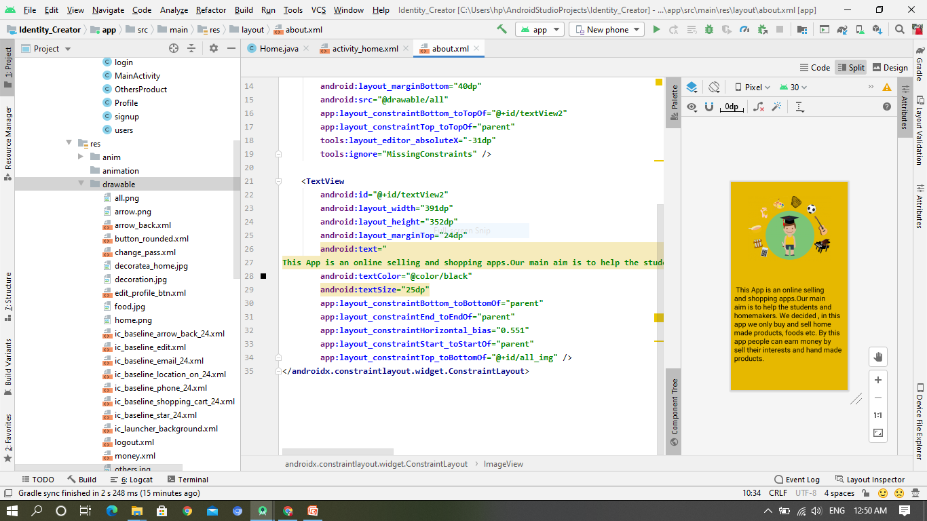

Slide 15
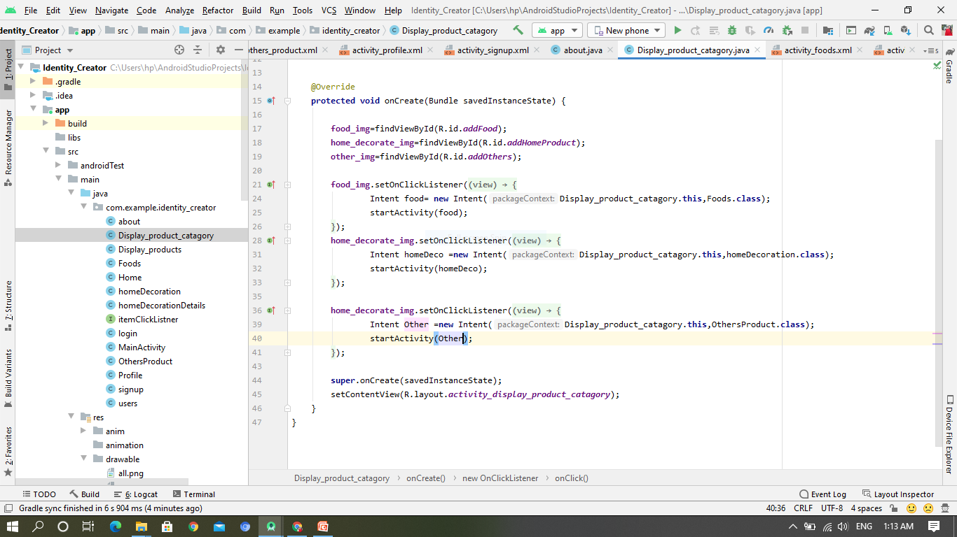

Slide 16
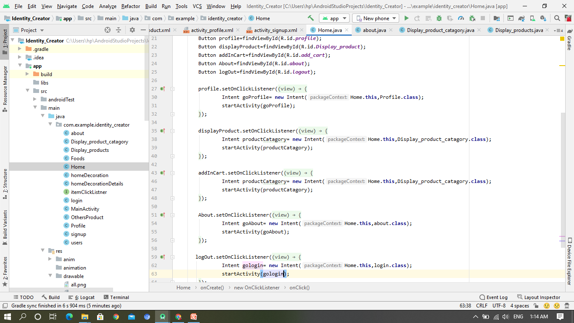

Slide 17
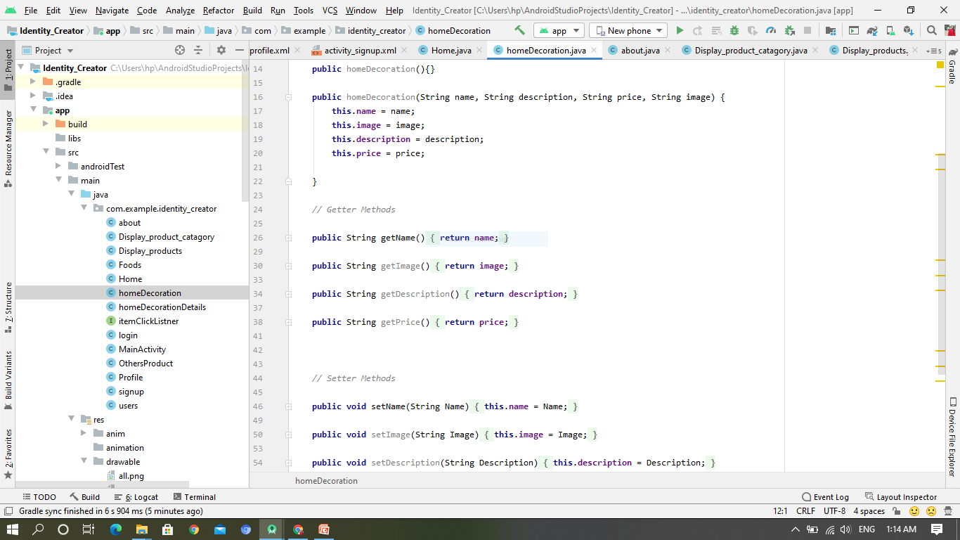

Slide 18
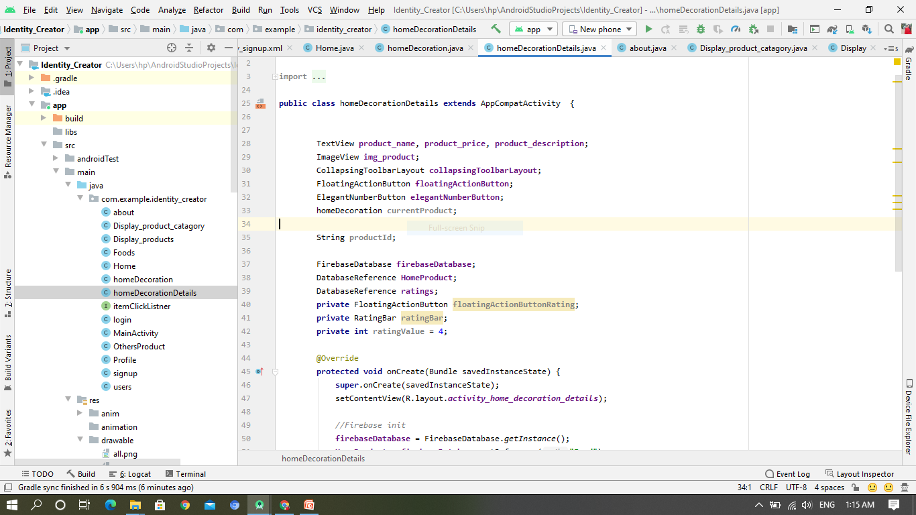

Slide 19
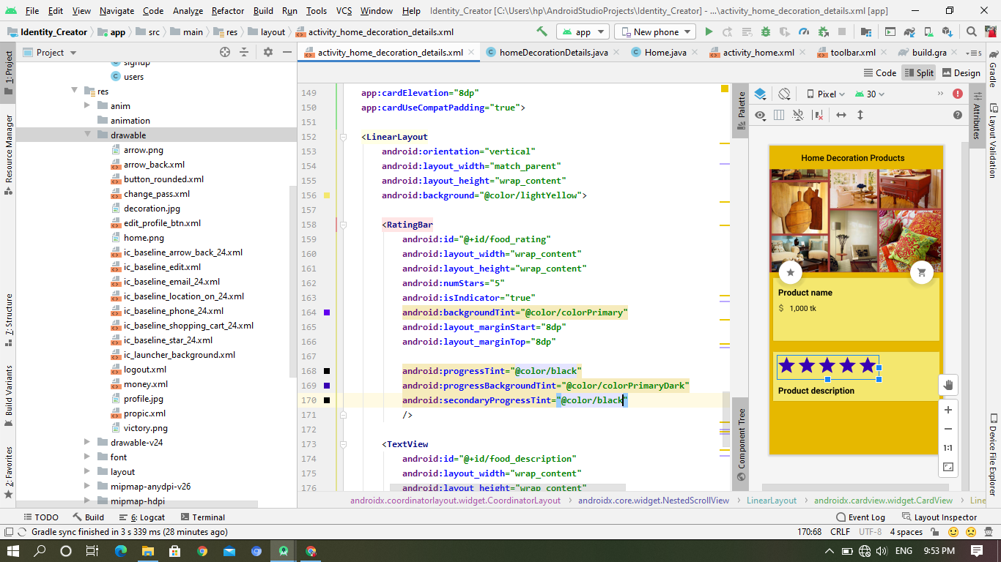

Slide 20
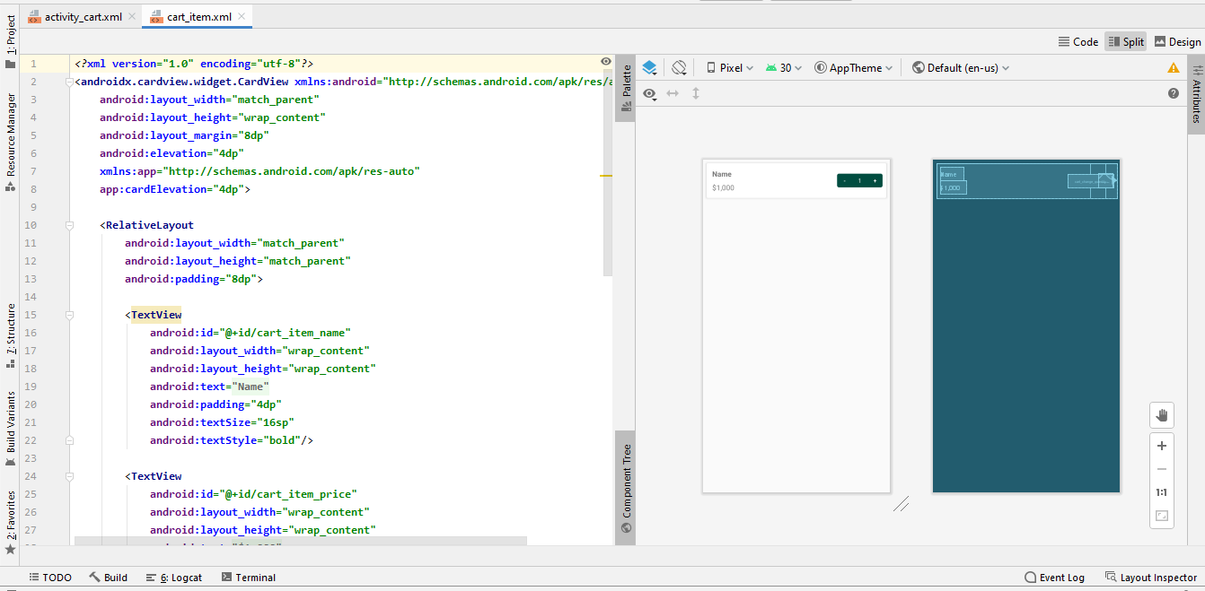
Coding Part of Shawon Das

Slide 21
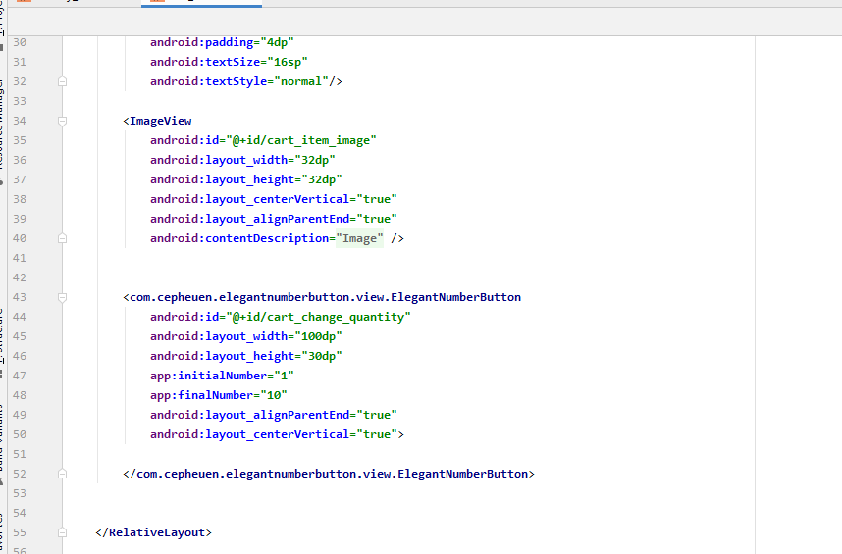

Slide 22
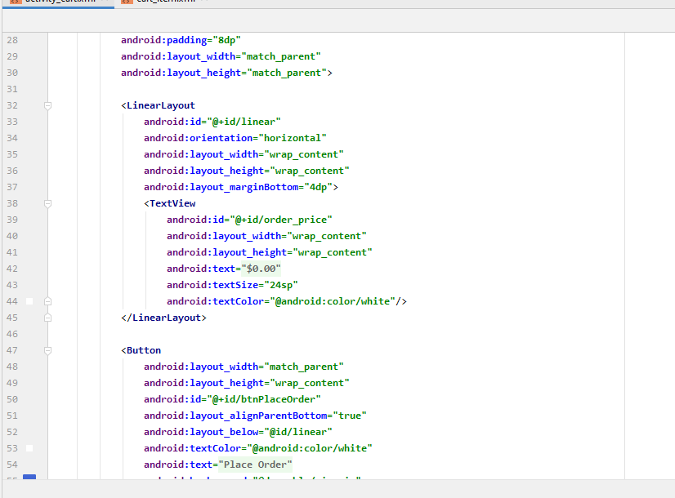

Slide 23
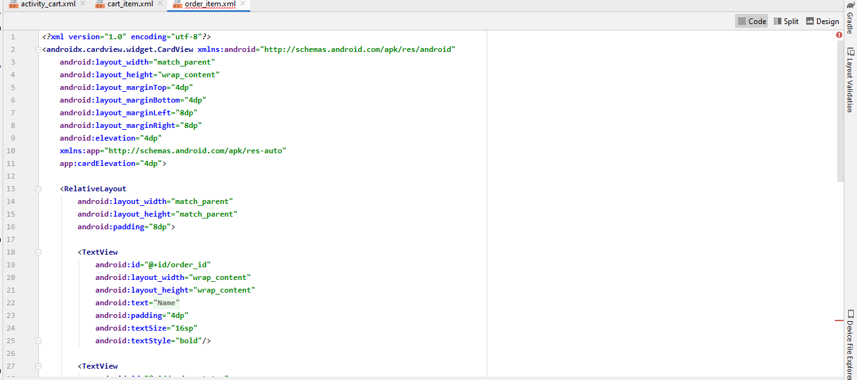

Slide 24
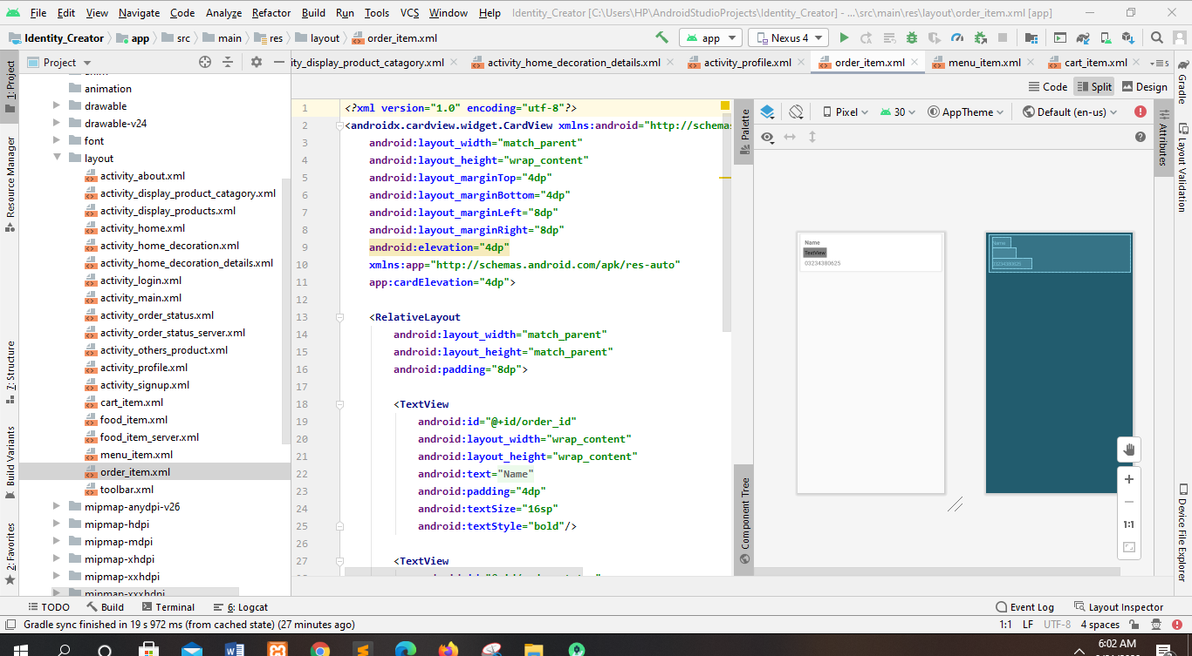

Slide 25
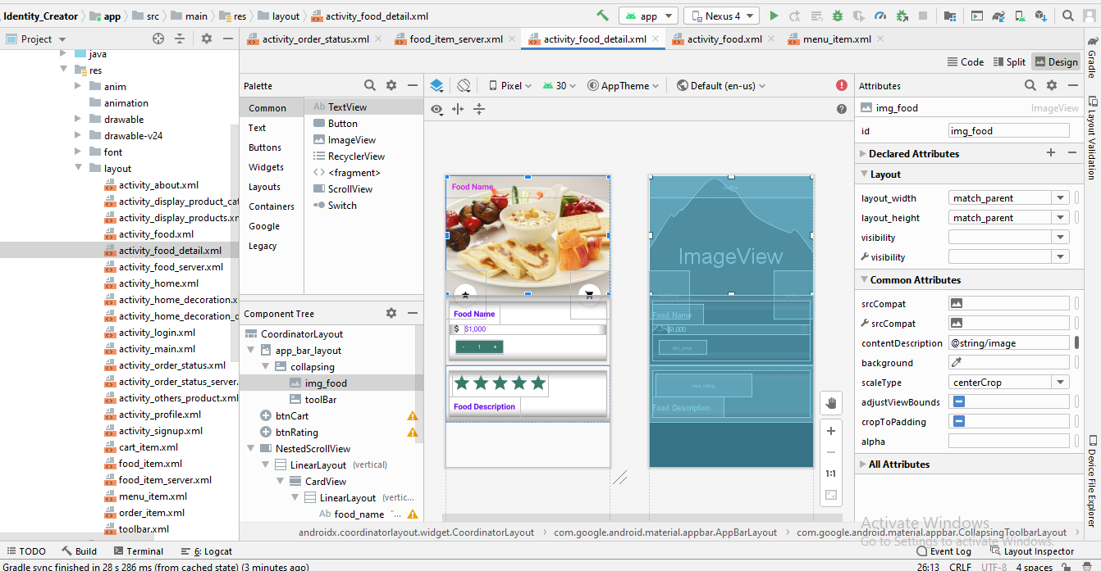
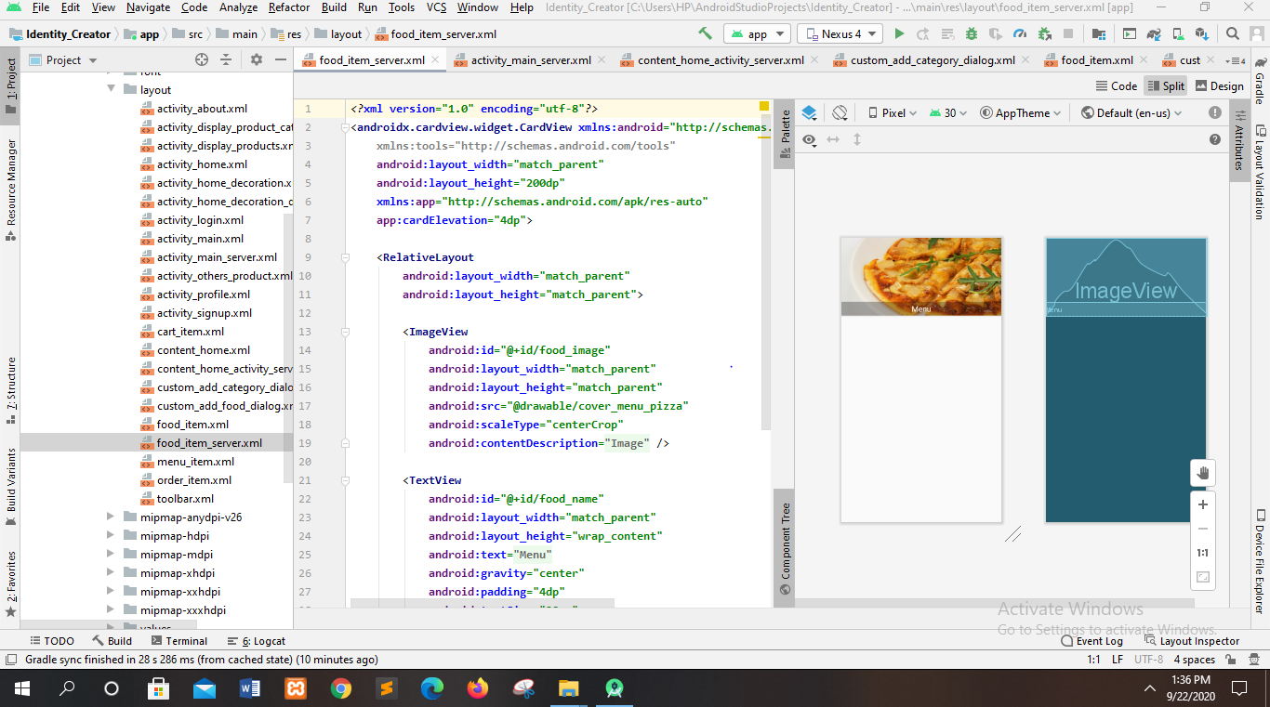

Slide 26
Problems
We were facing problems while running the code. We told you about that. According to your instruction we will mail you with the screen shots of our problems

Slide 27
Thank you

